Slide 1
India in the Global Economy
A paper in progress by
Raghuram Govind Rajan
A presentation by Ashwinbalaji Sundaresan

Slide 2
Agenda
Market Snapshot
What Should India do?
International Trade
Exchange Rate
The Goldilocks Rate
How to increase exports?
Updates

Slide 3
Market Snapshot
The global economy is finding it hard to restore pre-recession growth rates
Pre-recession financial boom left industrial countries with debt and overhang of debt
Consequences of population ageing and slowdown in productivity growth hiding underneath debt.
Structural reforms as a solution to increase potential growth
To help increase competition, foster innovation and drive institutional change
Hurt protected constituencies that gain rent from status quo
Gains are not immediate.
Industrial countries engaged in aggressive monetary policies
Causes surges in emerging market capital inflow and outflow depending on risk prevalent
Overcapacity in competitor countries threatens industries in India

Slide 4
What should India do?
International Investor is manic depressive and global growth is uncertain
Solution
Develop domestic environment that promotes strong and sustainable growth
Fiscal Prudence and lower current deficit
Inflation
Stressed Assets cleanup

Slide 5
International Trade
The global trade is growing more slowly than global output
Non-Traded services constitute greater percentage of GDP
Investment in trade intensive capital goods muted due to global overcapacity
Supply chain contracting due to increase in input sourcing within country
Expansion of Indian trade in double digits will be something of the past

Slide 6
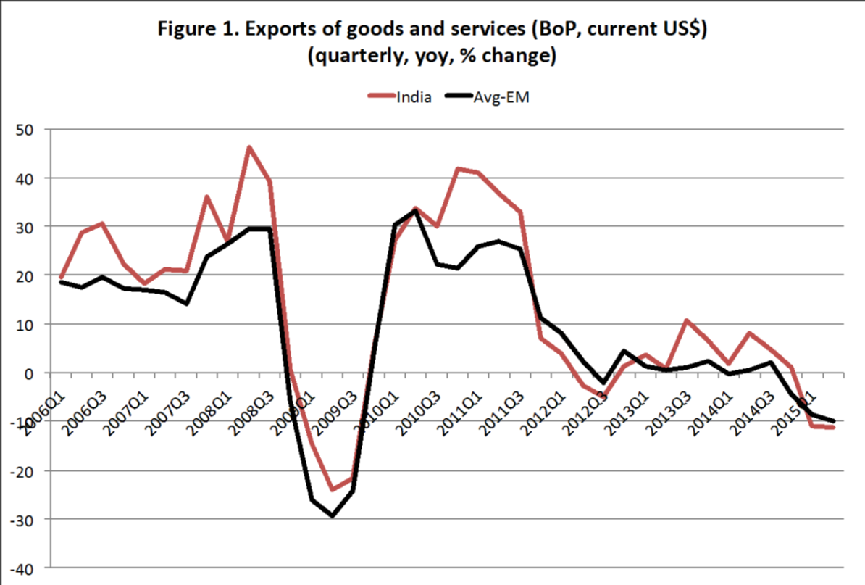
Trade Data

Slide 7
Trade Data (cond.)

Slide 8
Trade Data (cond.)

Slide 9
Exchange Rates
Rupee weakened by 6 percent against USD, since beginning of 2015, approximately the time when India’s export under performance started.
Why didn’t it increase exports?

Slide 10
Exchange Rates (cond.)
Other countries have depreciated against the dollar too
Although India might have gained an advantage versus USA producers, competitors might have gained more dude to their exchange rate dropping more
How do you remove the bias?

Slide 11
Exchange Rates (cond.)
Effect of Inflation on Interest rate

Slide 12
Exchange Rates (cond.)
Exchange rate is not overvalued
Real exchange rate measures only competitiveness
Productivity varies between countries
Rich countries are mostly at their productivity frontier
Room for growth in poor countries by reducing bottlenecks
Real appreciation offset by productivity differentials
Although Indian trade has been slowing down, slowdown similar to other countries. Significantly attributed to falling commodity prices and a smaller share to fall in trade volumes.
Thus very hard to pin the slowdown of exchange rate

Slide 13
Goldilocks rate
Should policies be geared towards a strong or a weak rupee?
Consumer is strong rupee focused
Producer is weak rupee focused
Goldilocks rate is the need of the hour
Determined by market
Reserve Bank of India intervenes to moderate adjustments to extreme sentiment driven movements
Temporary irrationality can overwhelm a central bank
Falling currencies may cause foreign investors to get out causing a cyclical effect.

Slide 14
Goldilocks rate (cond.)
Maintaining Order for rupee moment depends on the following
Solid policies that ensure macroeconomic stability and money safety over medium term
Attracting stable long-term cashflows over short-term funding.
“Make in India “ and attracting Foreign Direct Investment into the country.

Slide 15
Increasing Exports?
Exchange rate is not very helpful
Increase productivity by building infrastructure, improving human capital and access to finance
Increase BRICS interaction on policy issues and improve common approaches.
Build coalitions with sympathetic industries and negotiate bilateral and multilateral treaties with complete knowledge of consequences

Slide 16
Updates

Slide 17
Updates - Demonetization
Negative | Positive
Sharp fall in cash availability. | Loan rates could come down.
Higher job losses and lower farm incomes. Also caused social disruption, particularly in cash-intensive sectors. | Can reduce unaccounted income.
GDP growth fell mainly as cash crunch led to a slump in demand. Supply chains were hit because of unavailability of sufficient working capital. | Could support economic growth in the long-run if it succeeds in bringing down corruption.
Companies and households faced heightened uncertainty so they delayed investment and purchase decisions. | The government and the RBI will get wealthier when unreturned cash is destroyed.
Real estate prices and private sector wealth took a hit as some high-denomination notes were not returned. | In the long-term, demonetization may lead to higher tax collections as it expands and improves compliance.
Notes:
Demonetisation
The survey explains how Modi’s historic move to ban two high-value currency notes will have a transitional impact on the economy.
“The cash squeeze in the meantime will have significant implications for GDP, reducing 2016-17 growth by 0.25 to 0.5 percentage points compared to the baseline of 7%. Recorded GDP will understate impact on informal sector because, for example, informal manufacturing is estimated using formal sector indicators (Index of Industrial Production),” the survey says.
However, it also says that these effects will disappear soon as the currency circulation normalises. Apart from dealing with the economic impact, Indians have also suffered due to poor implementation of the currency ban. Subramanian, though, chose to remain silent about this.
“Economic Survey will not speak about the implementation,” Subramanian said during the press conference in New Delhi. Those in the informal sector have had to face hardships, but there are potential long-term benefits, he said.
Here are the top positives and negatives of demonetisation as highlighted by the Economic Survey:

